Slide 1
BONE & JOINT INFECTIONS -SURGICAL MANAGEMENT-

Slide 2
OVERVIEW
OSTEOMYELITIS -ACUTE
- SUB ACUTE
- CHRONIC
SEPTIC ARTHRITIS

Slide 3
Infection in bone
Osteomyelitis
acute (subacute)
chronic
specific (eg TB)
non specific(most common)

Slide 4
Acute Osteomyelitis
Source of Infection:
Hematogenous
Direct spread
Exogenous

Slide 5
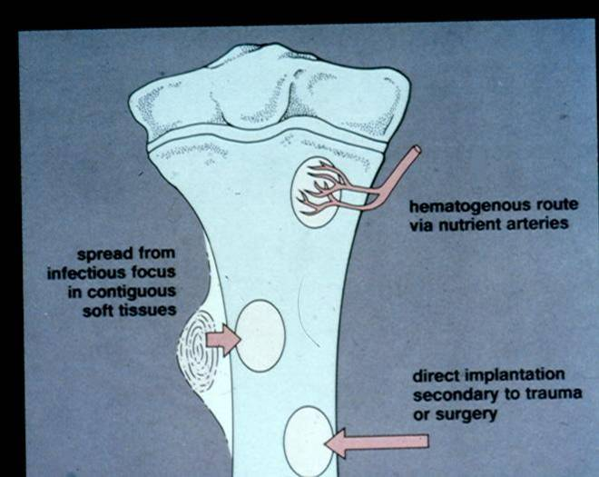

Slide 6
Acute haematogenous osteomyelitis
has been defined as
‘an inflammation of bone caused by pyogenic organisms settling from the blood stream, their presence being proven by culture or their effect on bone, this being demonstrated radiographically’
The duration of symptoms is less than two weeks .

Slide 7
Acute haematogenous OM
mostly children
boys> girls
history of trauma

Slide 8
Acute Osteomyelitis Source Of Infection
infected umbilical cord in infants
boils, tonsilitis, skin abrasions
in adults UTI, in dwelling arterial line

Slide 9
Acute Osteomyelitis Organism
Gram +ve
staphylococus aureus
strep pyogen
strep pneumonie
Gram -ve
haemophilus influnzae (50% < 4 y)
e .coli
pseudomonas auroginosa,
proteus mirabilis

Slide 10
Acute Osteomyelitis
Age variation
Neonates:
Extensive bone necrosis
Increased ability to absorb large sequestrum
Increased ability to remodel
Epiphysio-metaphyseal vascular connection leading to secondary septic arthritis

Slide 11
Acute Osteomyelitis Clinical Features
severe pain
reluctant to move
fever
malaise
toxemia

Slide 12
Acute Osteomyelitis Pathology
starts at metaphysis
?trauma
vascular stasis
acute inflammation
suppuration
necrosis
new bone formation
resolution

Slide 13
Acute Osteomyelitis
Pathology:
Primary focus and stage of inflammation
Spread of infection with pus formation
Formation of subperiosteal abscess
Pus tracks toward skin to form a sinus
Bone infarction (Sequestrum)
New bone formation (involucrum)

Slide 14
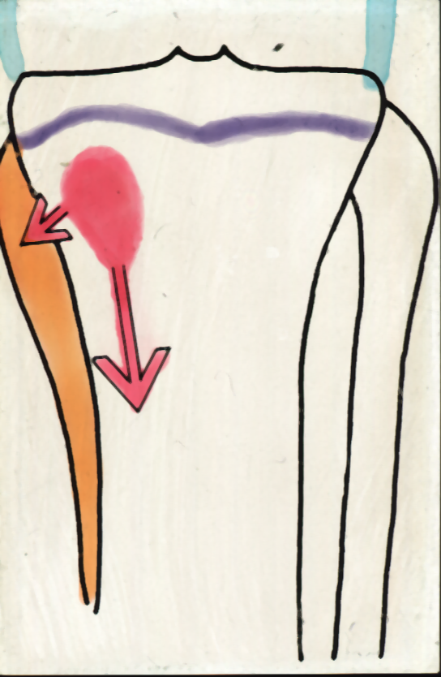
Acute Osteomyelitis

Slide 15
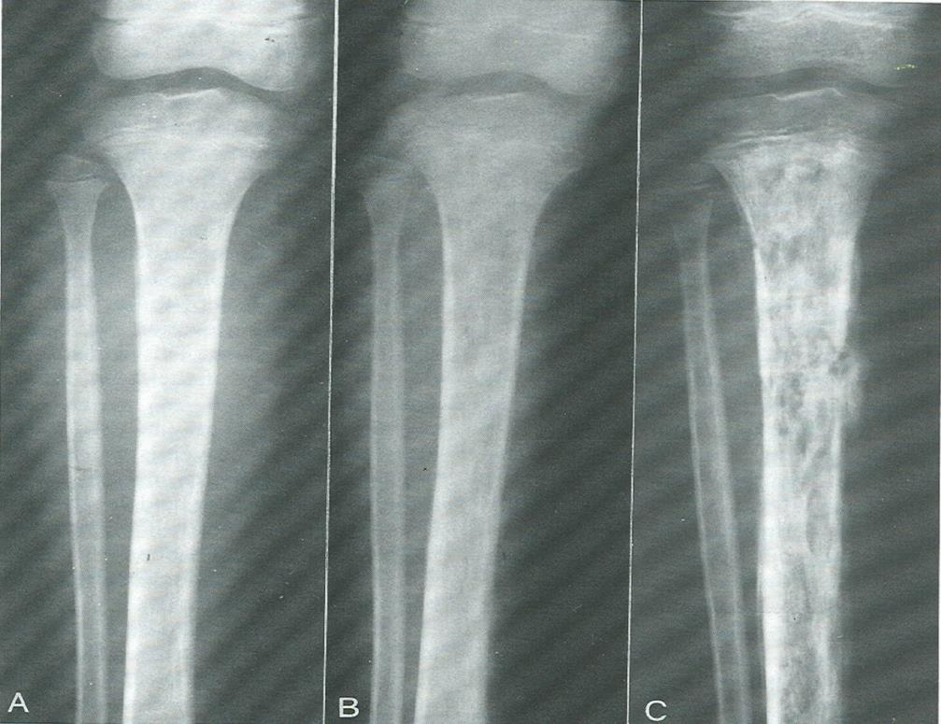

Slide 16
WHAT IS THE PLACE OF SURGERY

Slide 17
Acute Osteomyelitis
Treatment
Antibiotics:
Type?
Route?
When to start?
When to stop
Monitoring?

Slide 18
Acute Osteomyelitis
Treatment
Surgical Drainage:
Indications?
Procedure?
Drilling?

Slide 19
Acute Osteomyelitis Treatment
Drainage:
CF do not improve within 36 Hrs.
Signs of deep pus.( swelling, oedema, fluctuation).
If pus is aspirated.

Slide 20
Acute Osteomyelitis Treatment
supportive treatment for pain and dehydration
splintage

Slide 21
SUB ACUTE OSTEOMYELITIS

Slide 22
Subacute Osteomyelitis Clinical features
long history (weeks, months)
pain, limp
swelling occasionally
local tenderness

Slide 23
Subacute Osteomyelitis Pathology
Brodies abscess
a well defined cavity
in cancellous bone

Slide 24
SUBACUTE HEMATOGENOUS OSTEOMYELITIS BRODIE ABSCESS
On plain radiographs appears as a lytic lesion with a rim of sclerotic bone
S aureus is cultured in 50% of patients and in 20% the culture is negative
The condition requires open biopsy with curetage to make the diagnosis
The wound should be closed loosely over a drain

Slide 25
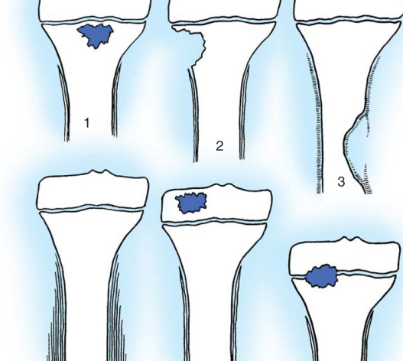
SUBACUTE HEMATOGENOUS OSTEOMYELITIS Gledhill classification

Slide 26
Subacute Osteomyelitis Investigation
X ray
Bone scan
Biopsy(50%) grow organism

Slide 27
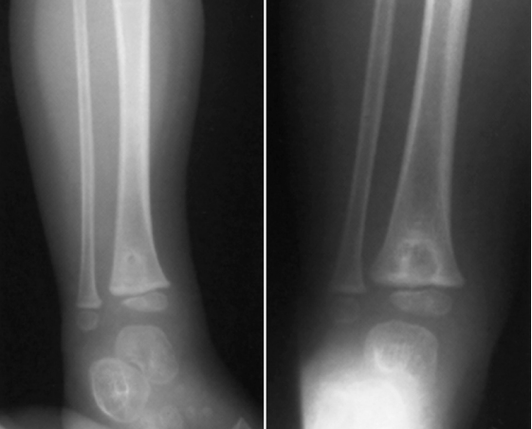
Brodie abscess

Slide 28
Subacute Osteomyelitis Treatment
Antibiotics - LONG TERM
surgery

Slide 29
CHRONIC OSTEOMYELITIS

Slide 30
CHRONIC OSTEOMYELITIS
Hallmark is infected dead bone within a compromised soft tissue envelope
The infected foci within the bone are surrounded by sclerotic, relatively avascular bone covered by a thickened periosteum and scarred muscle and subcutaneous tissue

Slide 31
com
Sinus track cultures usually do not corelate with cultures obtained at bone biopsy

Slide 32
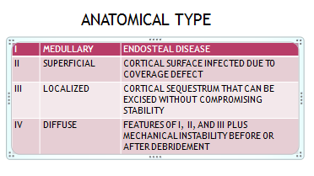
Classification of COM

Slide 33
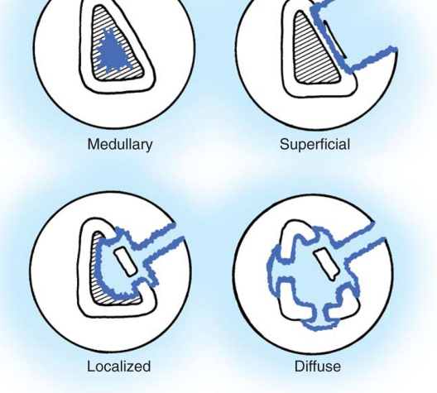
Anatomical classification

Slide 34
Diagnosis COM
Based on
Clinical
laboratory and
imaging studies

Slide 35
Clinical evaluation COM
Skin and soft tissue integrity
Tenderness
Bone stability
Neurovascular status of limb
Presence of sinus

Slide 36
Laboratory COM
Erythrocyte sedimentation rate
C reactive protein
WBC count only elevated in 35%
Biopsy for histological and microbiological evaluation
Staphyloccocus species
Anaerobes and gram negative bacilli

Slide 37
Imaging studies in COM
Plain X rays
Cortical destruction
Periosteal reaction
Sequestra

Slide 38
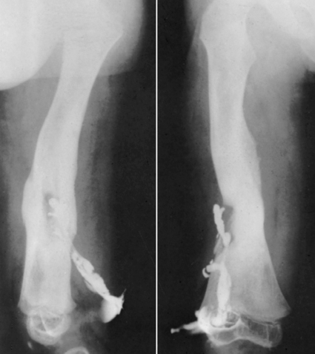
Sinography

Slide 39
Imaging -
Isotopic bone scanning more useful in acute than in chronic osteomyelitis
Gallium scans increased uptake in areas where leucocytes and bacteria accumulate. Normal scan excludes osteomyelitis

Slide 40
COM Imaging
CT Scan
Identifying sequestra
Definition of cortical bone and surrounding soft tissues

Slide 41
COM Imaging
MRI
Shows margins of bone and soft tissue oedema
Evaluate recurrence of infection after 1 year
Rim sign- well defined rim of high signal intensity surrounding the focus of active disease
Sinus tracks and cellulitis

Slide 42
Treatment of COM
Surgical treatment mainstay
Sequestrectomy
Resection of scarred and infected bone and soft tissue
Radical debridement
Resection margins >5mm

Slide 43
Surgical treatment of COM
Adequate debridement leaves a dead space that needs to be managed to avoid recurrence, or bony instability
Skin grafts,
Muscle and myocutaneous flaps
Free bone transfer
Papineau technique
Hyperbaric oxygen therapy
Vacuum dressing

Slide 44
Closed suction drains with high volume ingress & egress antibiotic irrigation system
Risk of contamination

Slide 45
Papineau Technique
Wound Debridement ,repeated sos,
Healthy granulation tissue & no infection
Autologous cancellous bone grafting from iliac
Antibiotig dressing / muscle flap
Wound closure with skin grafting

Slide 46
PMMA beads with Cephalosporins,Clindamycin,Gentamicin,Vancomycin
Delivers high concentration locally
10 to 80 days

Slide 47
Biodegradable antibiotic delivery systems
Calcium sulphate/Calcium phosphate with Vancomycin/Tobramycin
Absorbed in 8 weeks.

Slide 48
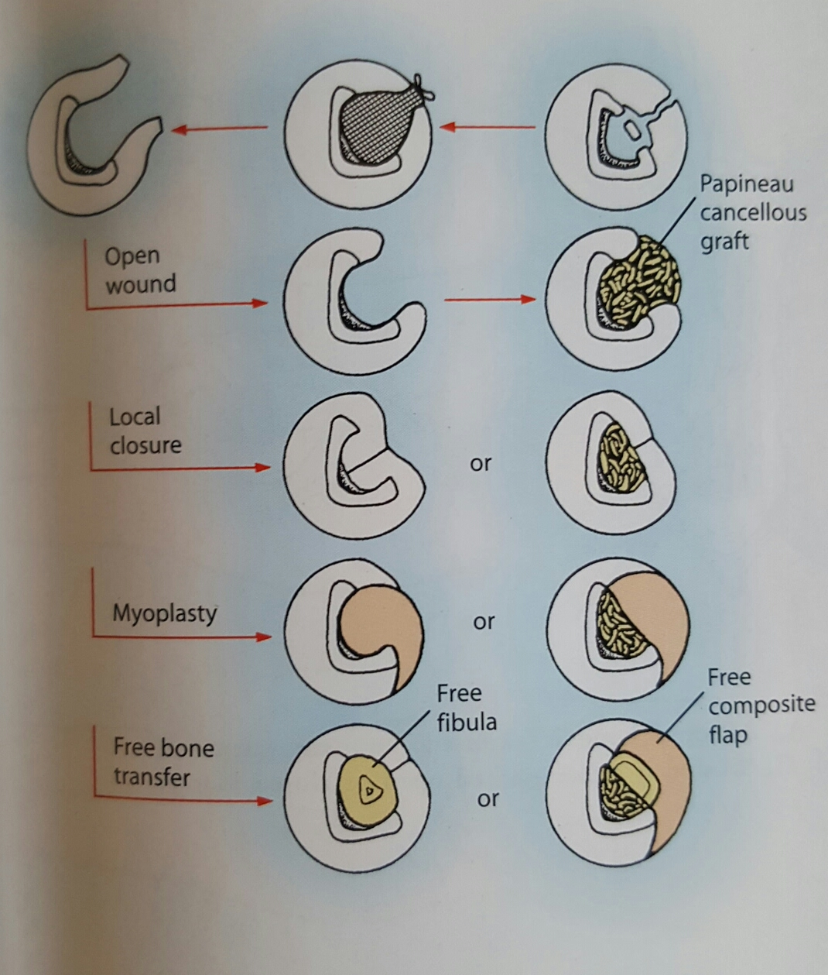

Slide 49
Resection of affected segment of bone
Ilizaro/ Monoplaner Ext Fixater
Corticotomy
Bone transport

Slide 50
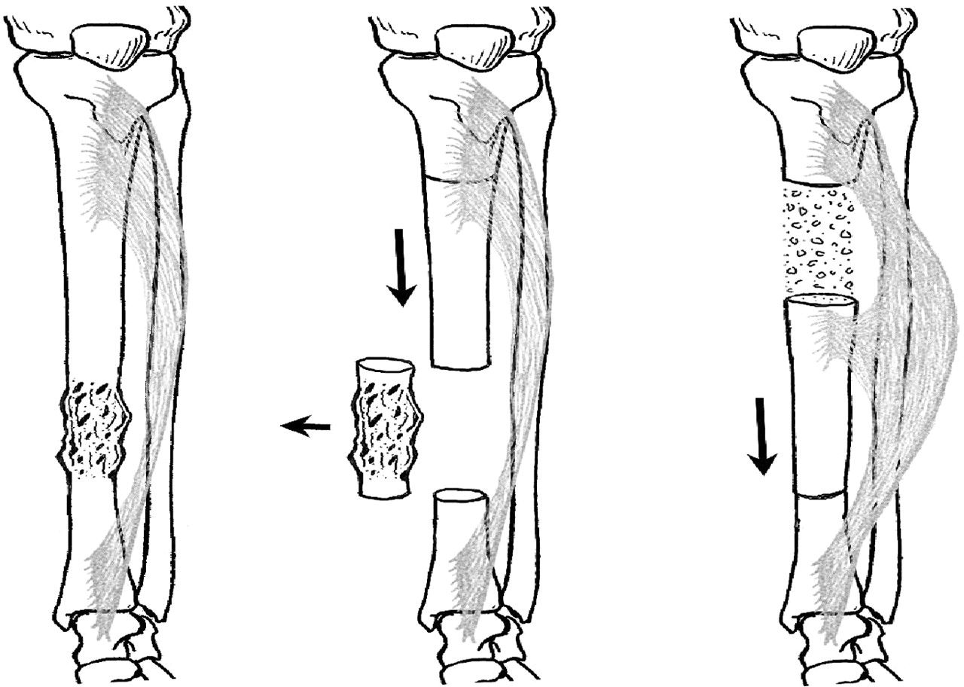

Slide 51
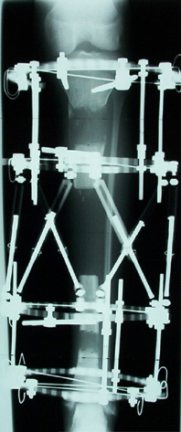

Slide 52
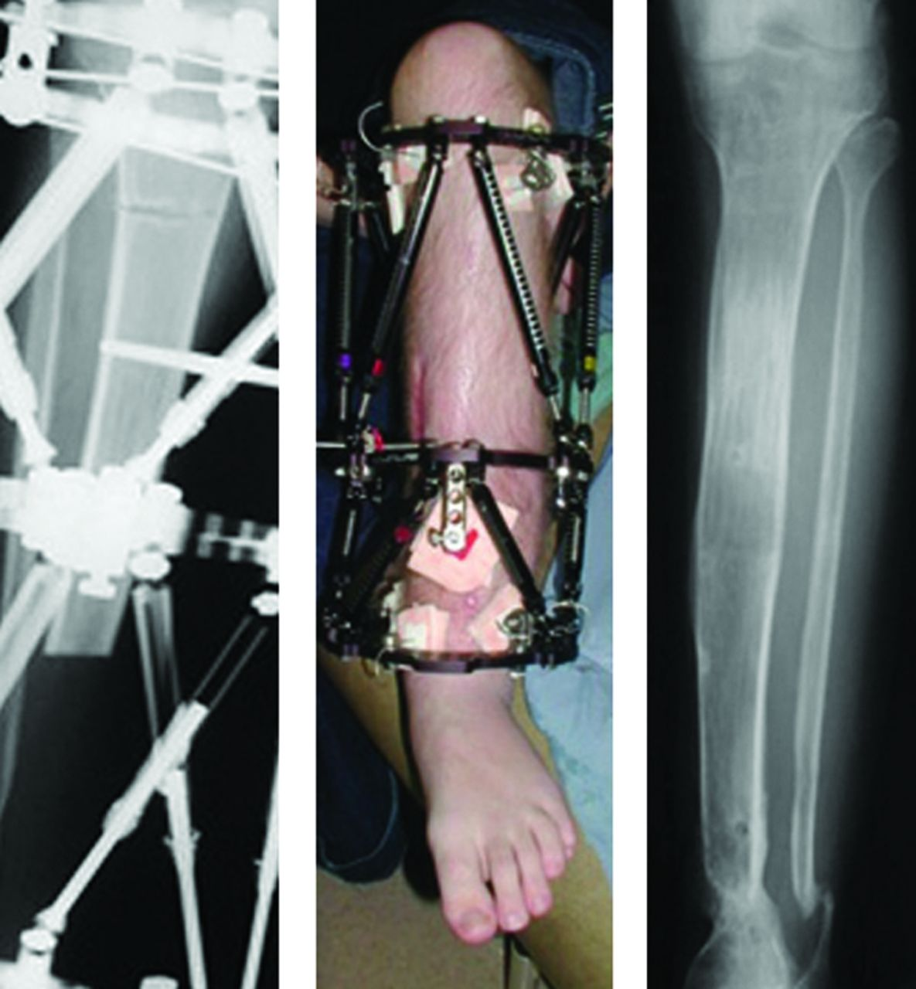

Slide 53
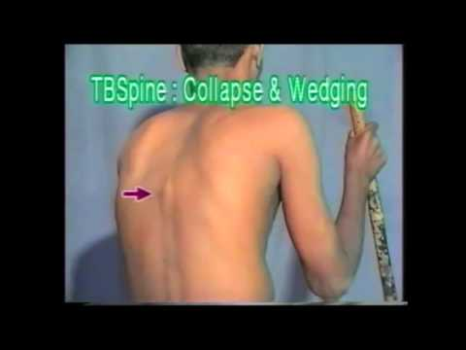
T B spine

Slide 54
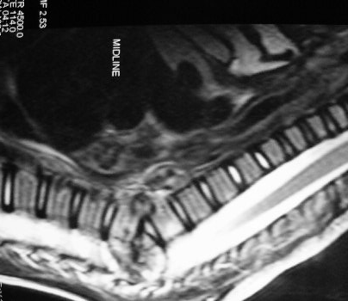

Slide 55
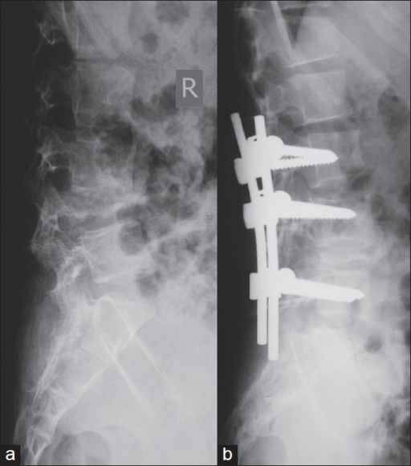

Slide 56
SEPTIC ARTHRIS

Slide 57
Definition
Acute joint infection due to bacterial agents
Medical emergency

Slide 58
Etiology (microbiology)
Microbial agent:
Staphylococcus aureus: most common (75-80%)
Other organism in special patients:
Sexually active woman: Neisseria gonorrheae
Elderly, IV drug abuser, immunocompromised, UTI: Gram negative (p. aeruginosa and E.coli)
SLE: Salmonella
HIV: Pneumococci, Salmonella, H. influenzae
Alcoholism, Humeral immunity abnormality, Hemoglobinopathies: Pneumococcal infections
Primary immunoglobolin deficiency: Mycoplasma

Slide 59
Root of infection:
Blood stream
Contiguous infection
Direct inoculation:
Injection: 0.0002
Arthroscopic surgery: < 0.005
Animal or human bite

Slide 60
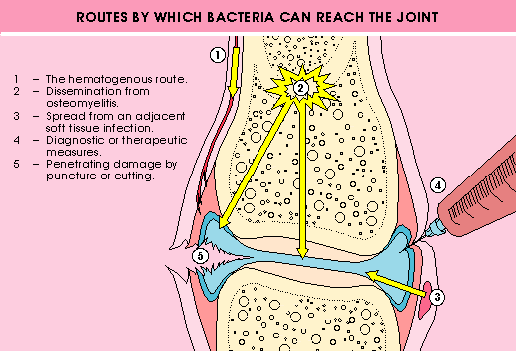

Slide 61
Site of involvement:
Mono (80-90%)
Knee: 55%
Ankle: 10%
Wrist: 9%
Shoulder: 7%
Hip: 5%
Elbow: 5%
SC: 5%- IV drug abuser
SI: 2%- IV drug abuser
Foot joints: 2%
Poly (more than 1 joint): RA

Slide 62
Clinical manifestations
Fever (toxic)
Acute
Sever pain
Sever swelling of one joint
Sever tenderness
Warmth
Sever effusion
Sever limited ROM

Slide 63
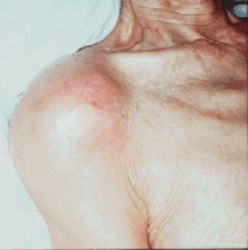

Slide 64
Diagnosis
Acute Monoarthritis
Sepsis workup
Biochemist
Synovial Fluid
Aspiration (rule)

Slide 66
Acute Monoarthritis
Sepsis workup
Biochemist
Synovial Fluid
Aspiration
Smear- Culture
Light microscope

Slide 67
TREATMENT
Antibiotic
Joint Drainage
Empiric (IV):
Smear
Age or Risk factors
Extra articular site
Definitive therapy;
based on culture

Slide 68
HIP – Aspiration – Blind / US guided_ Arthrotomy – Anterior approach
Knee – Aspiration-Arthrotomy or Arthroscopic Wash out
Shoulder – Aspiration
Arthrotomy - Deltopectoral

Slide 69
Arthrotomy/Arthroscopic – GA/ SA/ Regional/
Sterile Technique
Approach to the joint
Thorough wash out with N. saline /Antibiotic solutions
Suction Drain
Skin closure
Re wash out if necessary

Slide 70
Temporary splinting to prevent contractures
Early mobilisation
Delayed Wt bearing

Slide 71
Surgical Management Malignant Bone tumors

Slide 72
Classification of malignant tumors of bone:
Osteosarcoma (Osteogenic sarcoma)
Chondrosarcoma
Ewing’s sarcoma
Multiple myeloma

Slide 73
Osteosarcoma (Osteogenic sarcoma)
It is a malignant mesenchymal tumor in which cancellous cell produce bone matrix.
Most common primary malignant tumor of bone
Occurs in all age group but has bimodal age distribution
75% occur in person younger than 20 years of age
Second peak occur in elderly who have predisposing condition – Paget disease, bone infarct, prior irradiation
Males> females

Slide 74
Usually arise from metaphysis of long bones of extremities, and almost 50% occur about the knee.
Beyond the age of 25 years incidence in flat bones and long bones is almost equal.

Slide 75
Several subtypes of osteosarcoma are grouped according to –
Site of origin (intramedullary, intracortical or surface)
Degree of differentiation
Primary (underlying bone is unremarkable)or secondary to preexisting disorders.
Histological features (osteoblastic, chondroblastic, fibroblastic, telangiectatic, small cell and giant cell).
The most common subtype arises in metaphysis of long bones and is primary, solitary, intramedullary and poorly differentiated.
Grossly, Osteosarcoma are big bulky tumors that are gritty, grey-white, and often certain areas of hemorrhage and cystic degeneration.

Slide 76
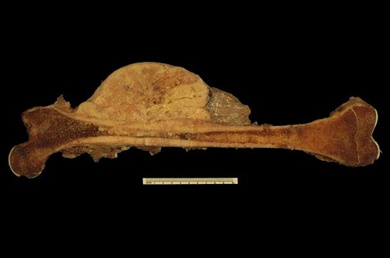
Osteosarcoma

Slide 77
Clinical features
Localized pain and swelling
Fast growing tumor
Progressive weakness and weight loss
Skin over the tumor is shiny and stretched with prominent veins
Warm, tender and ill defined margins.
Pulsatile tumor
Movement of adjacent joint restricted due to mechanical obstruction and effusion.
Regional lymph node enlarged only in 25-30% cases.
If distal neurovascular deficit present strongly suggest malignancy.
Lung metastasis occur in 10-12 months if left untreated.

Slide 78
Classic X-ray findings:
Codman's triangle (periosteal elevation)
Sunburst pattern/Sunrays appearance
Bone destruction
Ill-defined margins

Slide 79
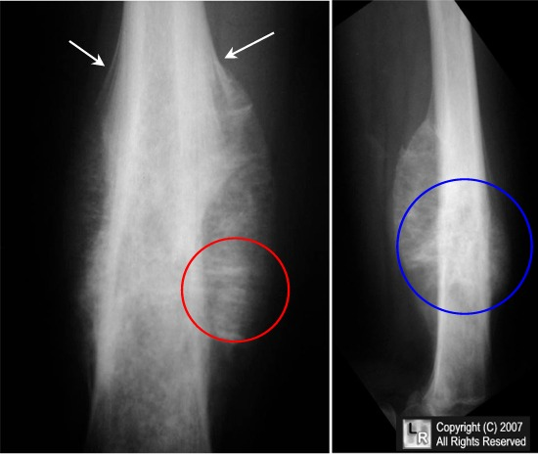
Codman’s triangle
Sunrays appearance
Osteosarcoma

Slide 80
Secondary osteosarcoma:
Occurs in old people
Associated with Paget’s disease or chronic osteomyelitis
Highly aggressive

Slide 81
Definitive diagosis - BIOPSY
Fine needle /Core needle
INCISION BIOPSY
well planned surgical incision, directly not through inter muscular septum, from the periphery of lesion, multiple samples

Slide 82
Standard Treatment
SANDWICH Therapy
Neoadjuvant Chemo – Surgery -Chemo

Slide 83
Definitive Surgery
Disarticulation
Amputation
Resection with reconstruction/endoprosthesis
Limb salvage surgery
Resection of metastatic lesion (lobectomy in lung)

Slide 84
Resection of the tumour
1 INTRALESIONAL – (debulking)
Palliative Sx in metastatic disease
Benign lesion not to sacrifice nerve/vessel
2 Marginal
Through pseudo capsule
In benign or some low grade malignancy
3Wide Resection
Margin of resection through normal tissue
Goal oin Sx for high grade malignancy
4Radical
Excision of all involved compartment/s

Slide 85
Limb salvage surgery
Principle is to eradicate the bone tumor, retain integrity of skeletal system and preserve the limb with useful function.
After resection, skeletal reconstruction done by bone grafting(auto or allograft) or by endoprosthesis (modular or custom made).
Prosthetic reconstruction is more effective
As compared to the radical amputation and external prosthetic fitting or limb sparing surgery with bone grafting this treatment is more effective in early mobilization.

Slide 86
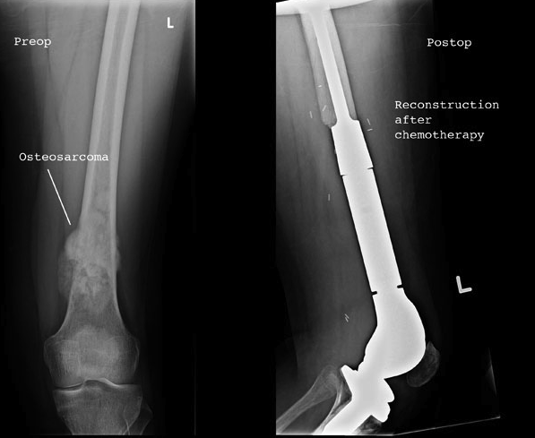

Slide 87
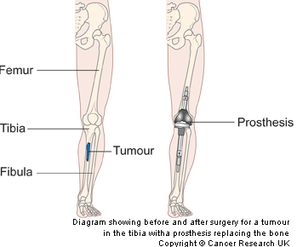

Slide 88
Chondrosarcoma

Slide 89
Chondrosarcoma
Definition:
Malignant tumor of chondroblasts cells
Second most common malignant matrix producing tumor
Etiology:
The tumor may arise de novo (primary) or secondary to preexisting enchondroma, exostosis (osteochondromas) or Paget’s disease
Primary chodrosarcoma is very uncommon, arises centrally in the bone and found in children

Slide 90
Chondrosarcoma sub classified according to –
Site – Central (intramedullary) -90 per cent
Peripheral (juxtacortical and surface)

Slide 91
Occur more commonly after 40 years of age
Male > female
It is most common in the femur, humerus, ribs and on the surface of the pelvis
Higher risk in patients with Ollier's disease (multiple enchondromatosis) or Maffucci's syndrome (multiple enchondromas and hemangiomas) .

Slide 92
Clinical features
A high-grade, fast growing tumor can present with excruciating pain.
A low grade, more indolent tumor is more likely to present as an older patient complaining of hip pain and swelling.
Pelvic tumors present with urinary frequency or obstruction or may masquerade as "groin muscle pulls".

Slide 93
Investigations
X – ray –
Chondrosarcoma is a fusiform, lucent defect with scalloping of the inner cortex and periosteal reaction. Extension into the soft tissue may be present as well as punctate or stippled calcification of the cartilage matrix.

Slide 94
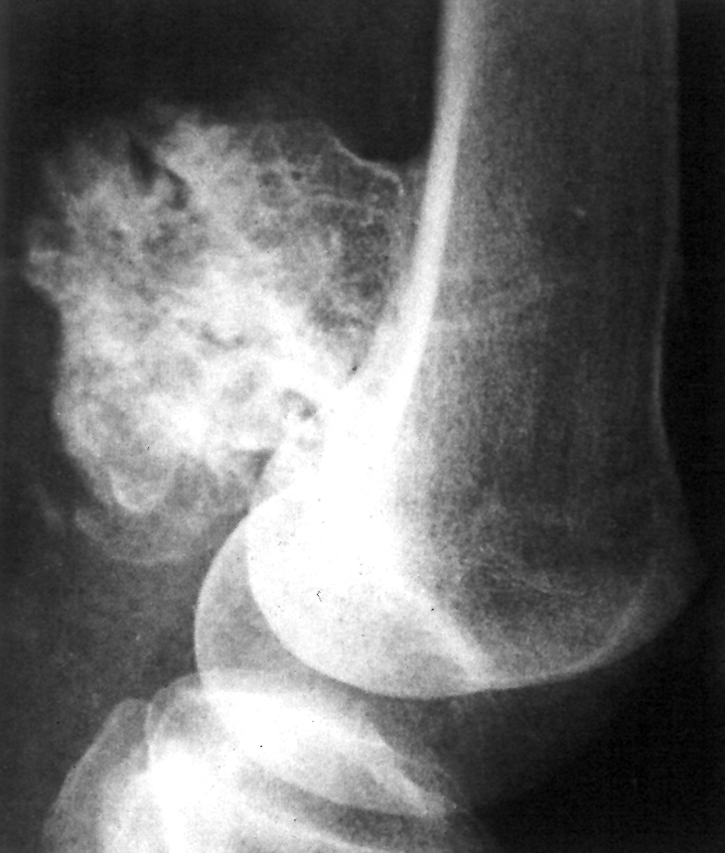
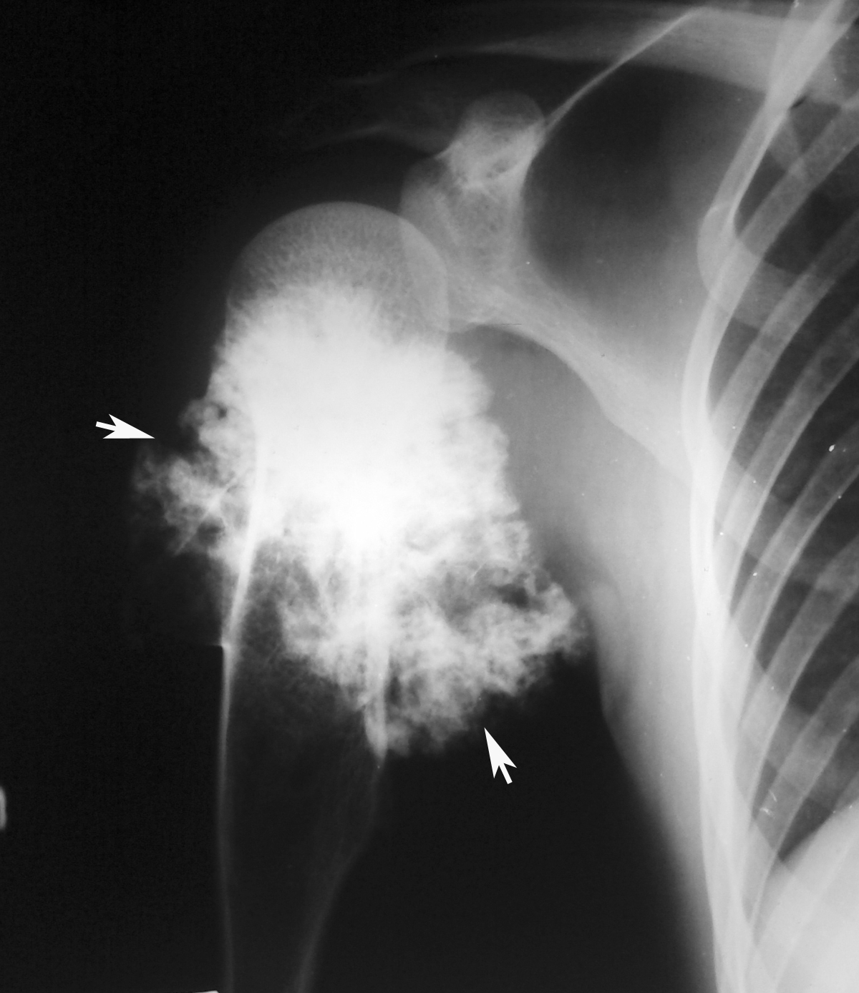
Chondrosarcoma

Slide 95
C.T. scan –
Helpful in defining the integrity of the cortex and distribution of calcification.
MRI –
Surgical planning as it demonstrates the intraosseus and soft tissue involvement of the tumor.
MRI is also helpful in evaluating possible malignant degeneration of osteochondromas by allowing accurate measurements of the cartilage cap

Slide 96
Biopsy - Incisional biopsy done

Slide 97
Treatment
Treatment of chondrosarcoma is wide surgical excision. There is a very limited role for chemotherapy or radiation.
Low grade tm. – Limb salvage surgery(WLE)
High grade tm. - Amputation

Slide 98
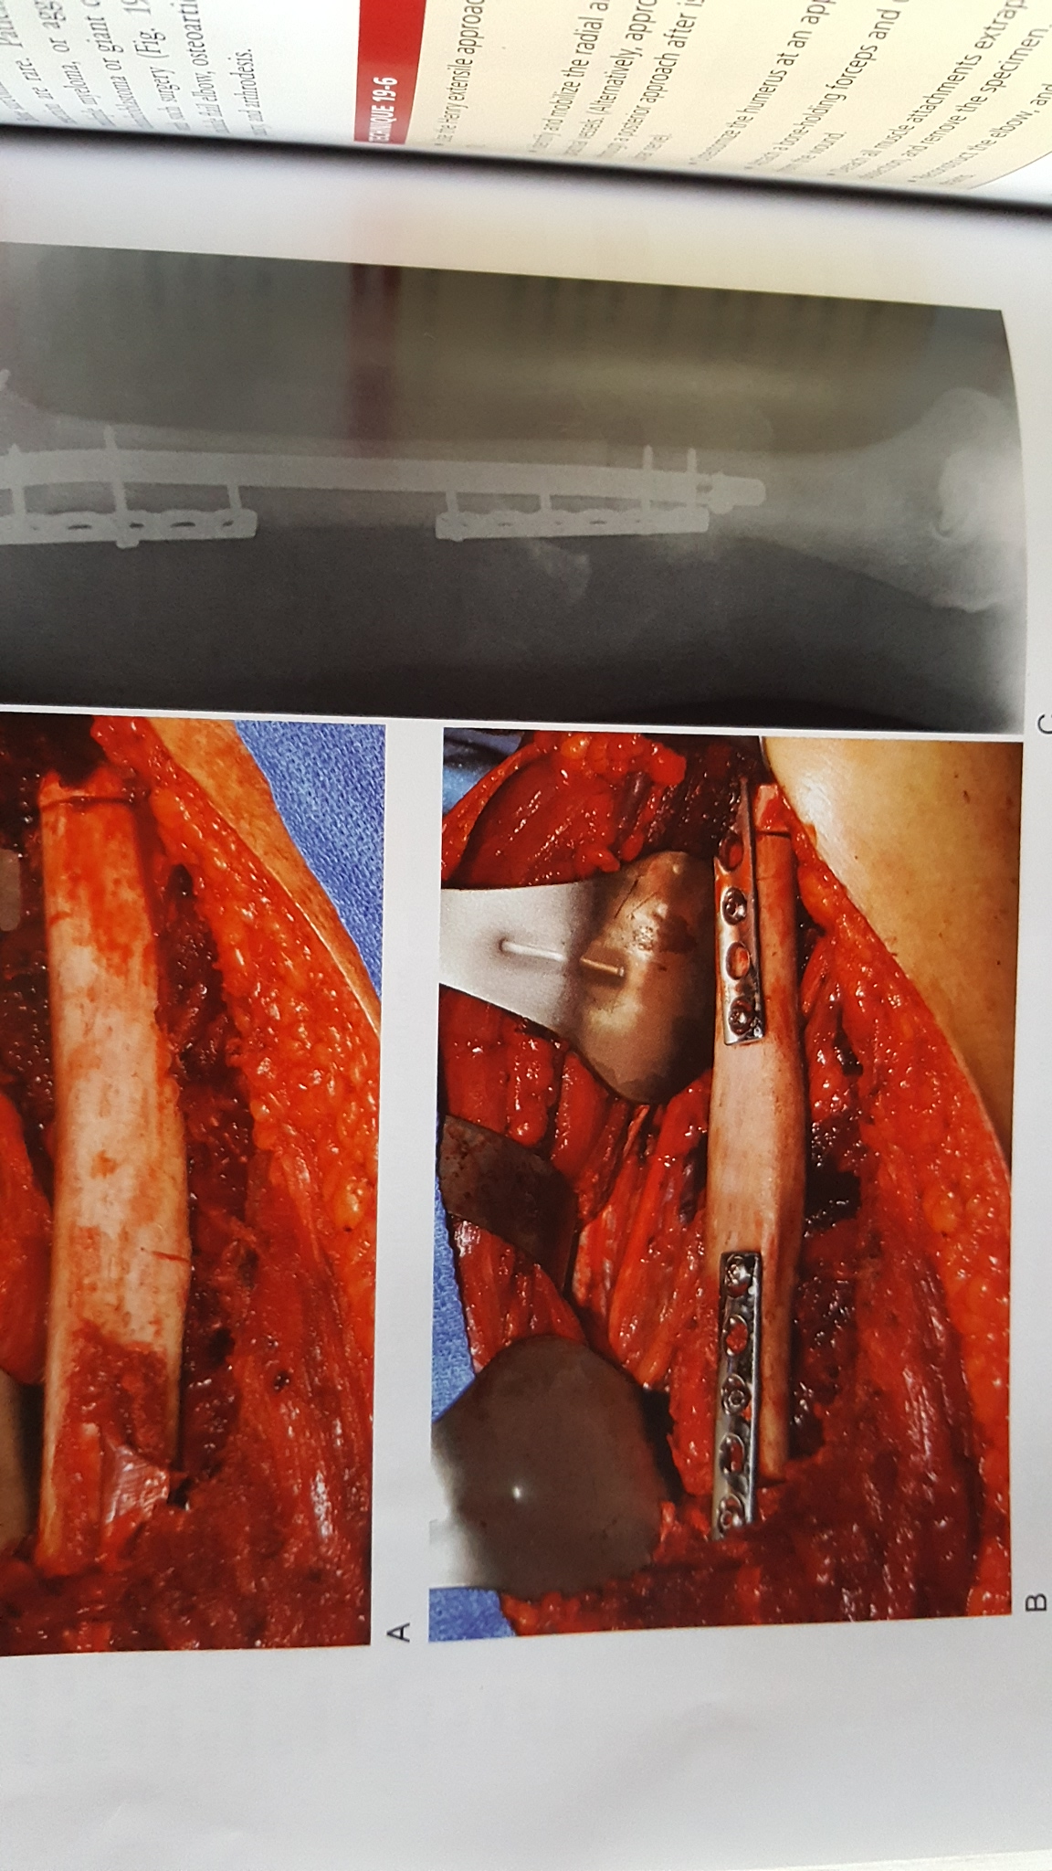

Slide 99
Osteochondroma
( Exostosis)

Slide 100
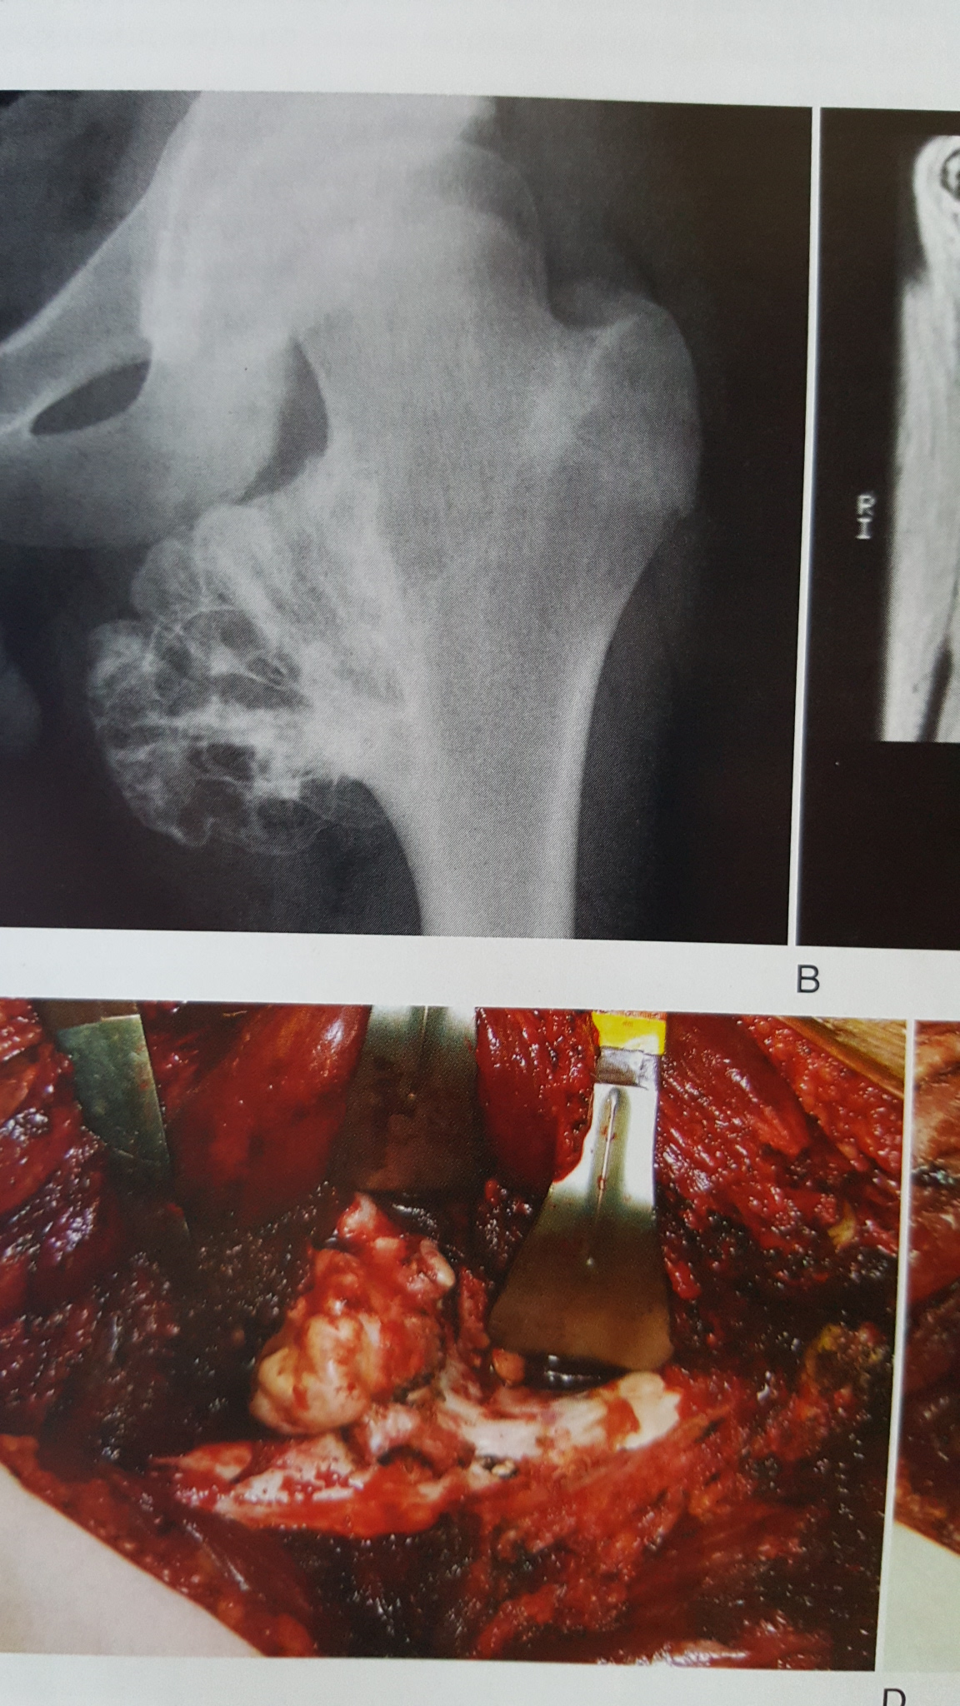

Slide 101
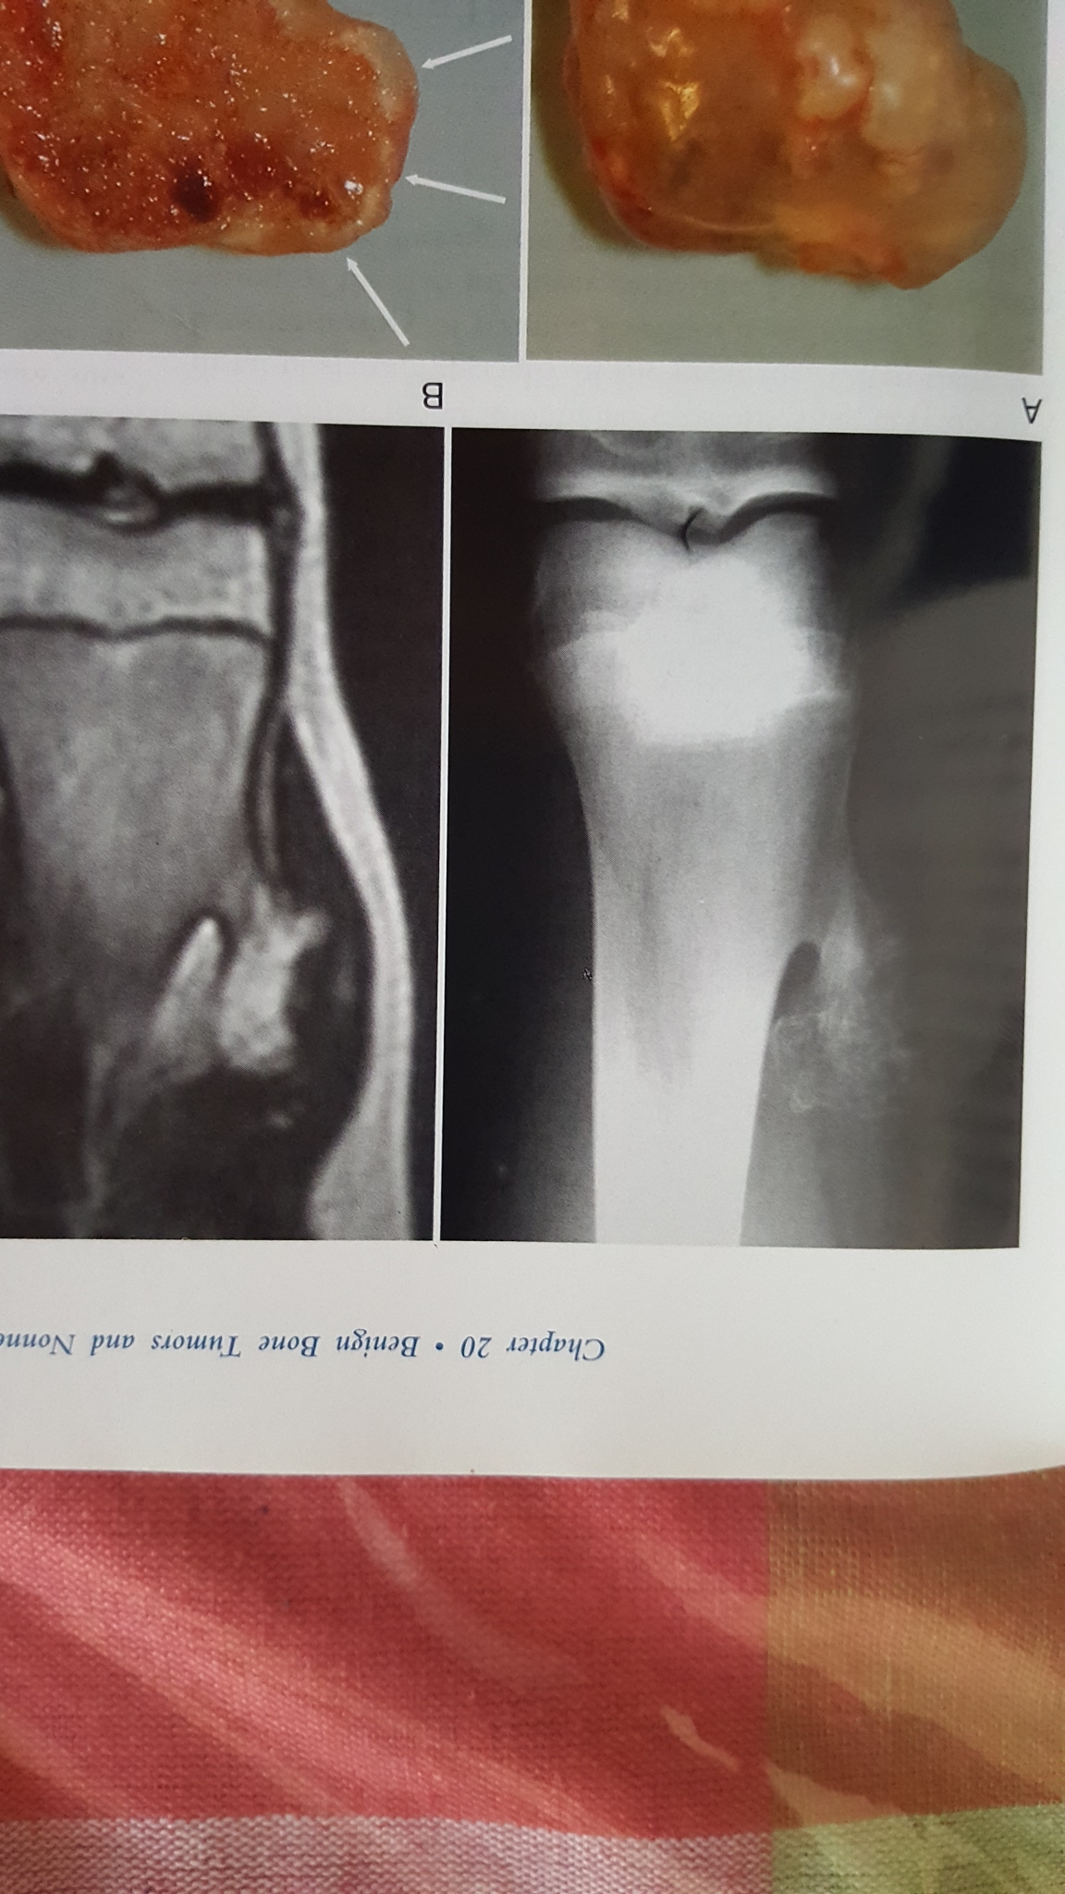

Slide 102
Solitary Bone Cyst

Slide 103
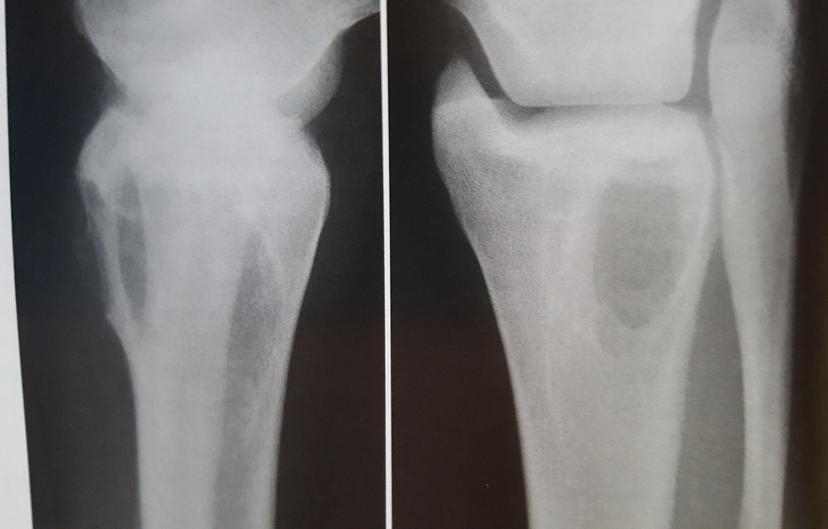

Slide 104
Aneurismal Bone Cyst

Slide 105
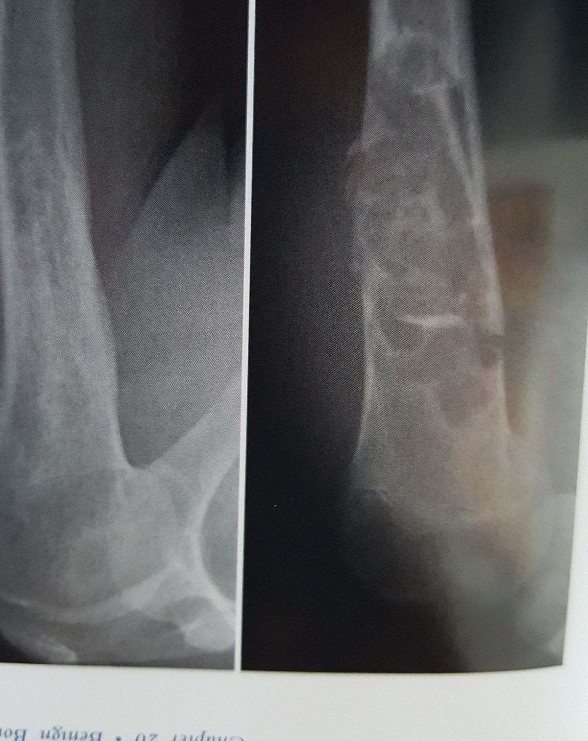

Slide 106
Osteoclasoma

Slide 107
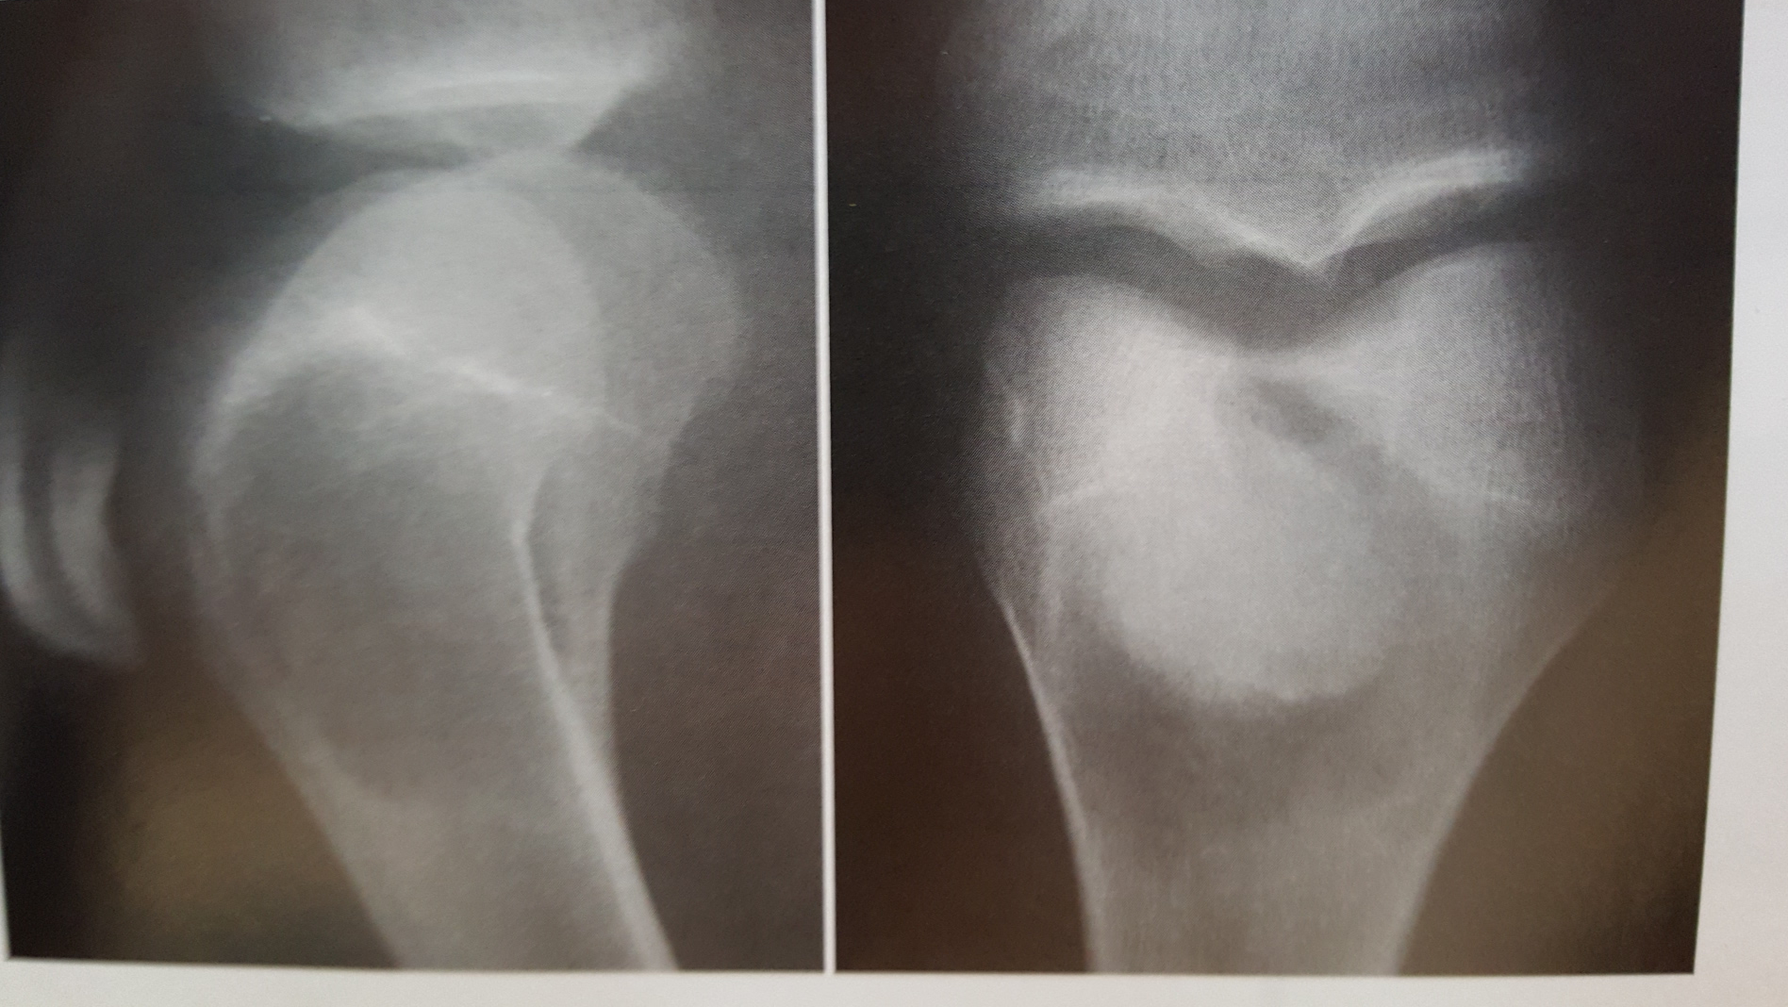

Slide 108
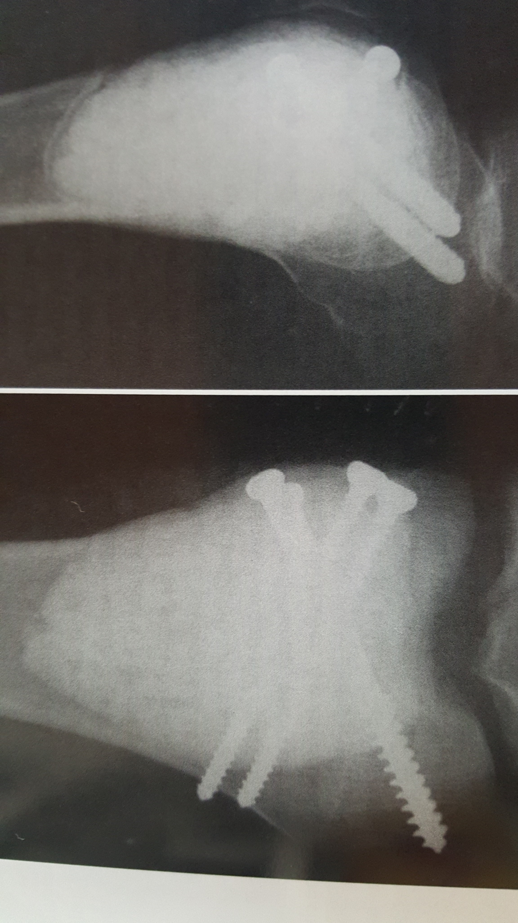

Slide 109
Thank You

